Slide 1





Making Policy Work for People Doing the Work
Abhilash Kantamneni, Director of Action Research
Aug 14, 2024

Slide 2


Efficiency Canada is the national voice for an energy efficient economy.
We envision a future where Canada uses energy efficiency to its fullest potential.

Slide 3

Our expertise
Research and identify effective energy efficiency policies
Communicate the benefits and significance of investing in energy efficiency
Mobilize the energy efficiency community for collective action and change

Slide 4
Do you believe in miracles?

Slide 5

The perfect gift,
is a “miracle”
  Profoundly positive outcome
  Inner workings mysterious
  Exceeds norms and expectations
  Transforms routine course of life
Perfect gift! Don’t know you need one till you have one.
Perfect gift! Don’t know you need one till you have one
Source: rawpixel.com

Slide 6

Decarbonization contractors
are expected
to perform miracles
  Technical
  Social
  Financial

Slide 7
Miracle #1: Technical
  Bespoke custom projects
  New systems sensitive to install quality
  House as a system of systems
  Must sequence projects over long time

Slide 8
Miracle #2:
Social
  Earning homeowner trust
  Sustain consumer confidence
  Shift business practices from
    Transactional -> relational
    One-time -> long-term
    Combative -> collaborative

Slide 9
Miracle #3: Financial
  Margins, closing-ratios, call-backs
  Seasonal feast and famine
  Stop-start programs
  Employee retention, advancement
  Consolidation, buy-outs, succession planning (or lack thereof)

Slide 10
Do you believe in miracles?
(I do!)

Slide 11

For decarb to scale, “miracles”
must be…
  Mundane
  Repeatable
  Reproducable
  Scaleable

Slide 12

Value creation on both
sides of kitchen table
What would such business models look like?

Slide 13
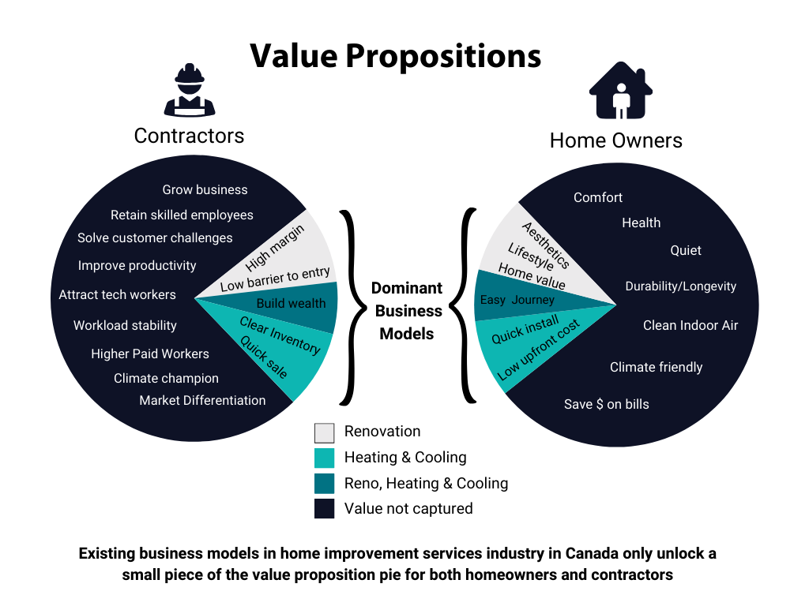

Slide 14
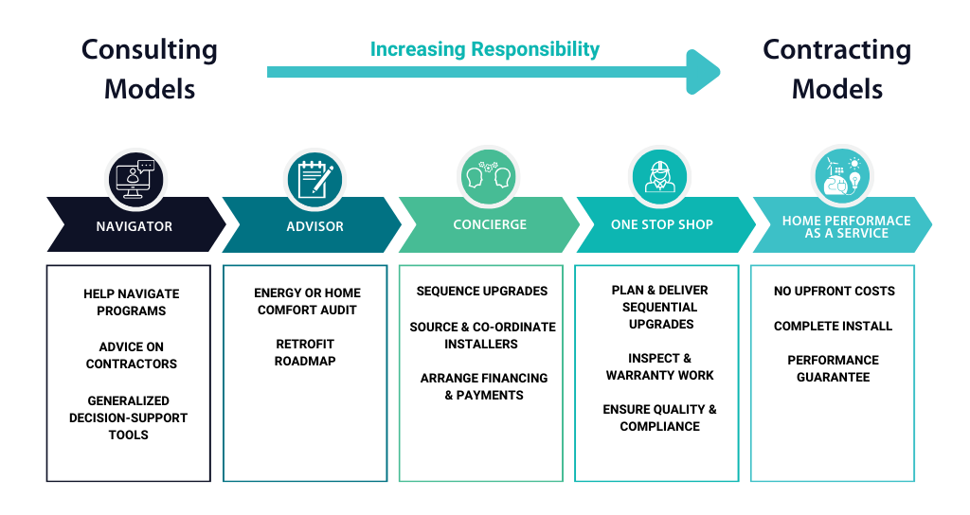

Slide 15

Change is not spontaneous
Need to:
  (Re)invest resources
  Navigate uncertainty
  Reconfigure core functions
  Scale operations
  Normalize practices

Slide 16
Why business supports are important
  For decarbonizing Canadian homes:
  Businesses themselves must drive market transformation towards beneficial decarbonization
  Maintain consumer confidence
  Scale the pace and depth of retrofits necessary to meet net-zero goals
  For Canada’s prosperity:
  Good middle-class jobs
  Wealth creation
  Stable reliable careers with opportunities for growth
  Pursue craftmanship and excellence
  Small business leadership

Slide 17

Turning “miracles”
into the mundane
How to design retrofit policy for people that do the work?

Slide 18
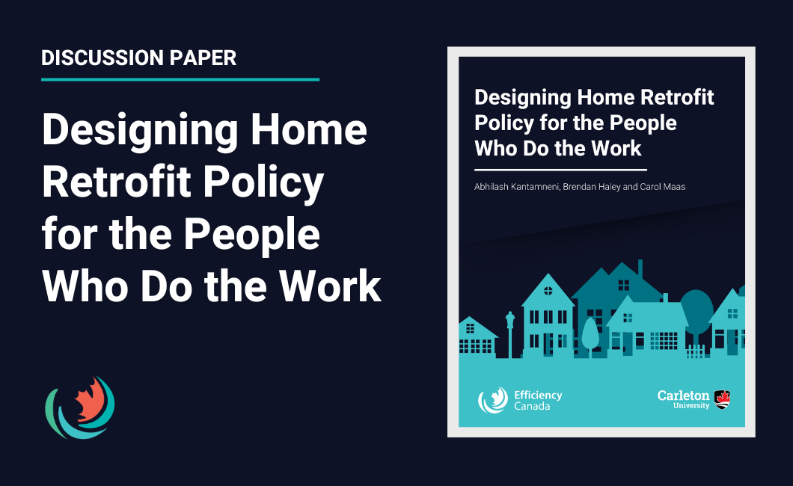
Our research project

Slide 19

Decarbonization
is like engine swap-outs
  Complex
  Iterative
  Custom
  Must be “good for business”

Slide 20

Supporting business model change
What is the role of policy?

Slide 21
Promising business support policies
Upstream incentives
Performance standards
Long-term financing
Improved data access
Concierge services
Consumer awareness
Mentoring
& coaching
Modernization supports & training
Business accelerators

Slide 22
Transform incentives and financing
Upstream incentives
Performance standards
Long-term financing
Improved data access
Concierge services
Consumer awareness
Mentorship
& coaching
Modernization supports & training
Business accelerators

Slide 23
Transform incentives and financing
Upstream incentives
Performance standards
Long-term financing
Improve consumer confidence
Improved data access
Concierge services
Consumer awareness
Mentorship
& coaching
Modernization supports & training
Business accelerators

Slide 24
Transform incentives and financing
Upstream incentives
Performance standards
Long-term financing
Improve consumer confidence
Improved data access
Concierge services
Consumer awareness
Mentorship
& coaching
Modernization supports & training
Business accelerators
Support business innovation

Slide 25
Transform incentives and financing
Upstream incentives
Performance standards
Long-term financing
Improve consumer confidence
Improved data access
Concierge services
Consumer awareness
Mentorship
& coaching
Modernization supports & training
Business accelerators
Support business innovation

Slide 26
Upstream incentives
  Performance based incentives for contractors and renovators.
  Upstream incentives to make every AC a heat-pump.
  Caution: misaligned incentives may cause unintended consequences.

Slide 27
Performance standards and certification
  Minimum energy performance standards for homes? Indoor IAQ standards?
  ACCA QI certification or other third-party verification?
  Caution: Admin costs cumbersome, is there consumer demand?

Slide 28
Expanded financing for homeowners
  On-bill financing (pay back through utility bills?)
  PACE financing (pay back through property taxes?)
  Energy efficiency HELOC?
  Long-term public financing?
  Caution: pair with consumer protection.

Slide 29
Improved access to data
  Business innovation grants?
  Expedited permitting?
  Service modernization training?

Slide 30
Concierge and Consultative Services
  Tailored solutions for underserved markets?
  Consumer aggregation?
  Design to spec?
  One-stop project management and retrofit sequencing?
  Caution: more intermediaries, more friction?

Slide 31
Consumer awareness and education
  Mandatory building energy labelling?
  Realtor training?
  Public education campaigns?
  Consumer protection?
  Extended OEM warranty?
  Caution: need to take whole-home approach

Slide 32
Mentorship and coaching
  Peer-peer business mentoring?
  HVAC center of excellence?
  Business strategy coaching?
  Advisory services?
  Caution: must coordinate for public good

Slide 33
Modernization supports and training
  FSM and CRM training?
  Expedited permitting?
  Remote diagnostic tools?
  Easy to use system sizing software?
  Micro-grants for process improvements?
  Caution: no one-size fits all

Slide 34
Business incubators and accelerators
  Business fundamentals training?
  Custom courses and learning modules?
  Small business administration skills?
  Business model coaching?
  Caution: need non-credentialed pathways to success

Slide 35

Bringing it all together
How policy can work for people doing the work

Slide 36
Key insights
People doing the work of decarbonization are expected to perform “miracles”
Dominant business models fail to capture significant value for both contractors and homeowners
Business model change necessary policy pillar for home decarbonization and for Canada’s prosperity
Change is not spontaneous
Home performance is a strategic sector that needs its own business supports

Slide 37
Key recommendations
Facilitate business model transformation; no single policy can achieve this
Focus must be on transforming customer-contractor relationships
Business supports must be tailored to meet needs of people doing the work
Provide targeted funding, advisory services, networking opportunities and policy coordination

Slide 38

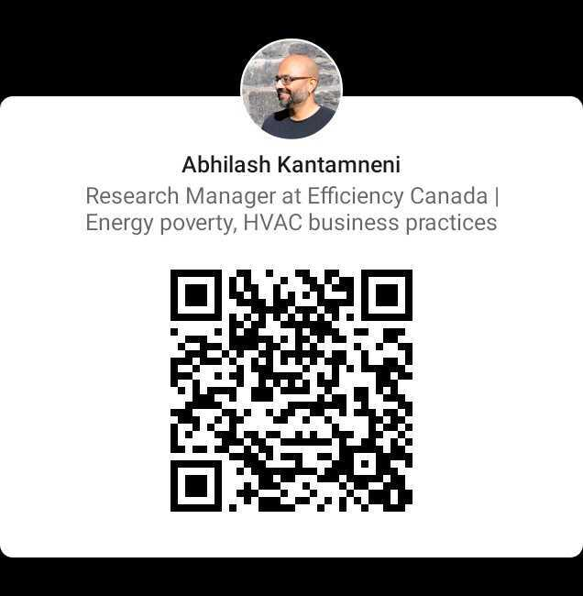
Sign up, stay engaged
Connect with me

